Slide 1

PBCST504 – MICROCONTROLLERS
MICRO PROJECT
Zeroth Review

Slide 2
Title:-
SMART HOME INTRUSION DETECTION SYSTEM
Group No: 6
Members: JEC24CC009 FARHAN
JEC24CC012 AKSHAY KJ
JEC24CC029 CLEETUS TJ
LJEC24CC064 ALEEN ANTU
LJEC24CC066 ARJUN MR
Project Coordinator:
Ms.Sagna L T
Asst. Prof. CSE(CY)

Slide 3
DEPARTMENT OF COMPUTER SCIENCE & ENGINEERING
(Cyber Security)
Vision of the Department
To be a globally recognized centre of excellence in Cyber Security education, research and innovation by nurturing ethical professionals , fostering technological advancement through responsible practice and contributing to a secure and sustainable digital society.

Slide 4
DEPARTMENT OF COMPUTER SCIENCE & ENGINEERING
(Cyber Security)
Mission of the Department
M1: Excellence in Education : To provide outcome-based and industry-oriented education by integrating core computer science principles with advanced cybersecurity technologies and practices.
M2: Ethics and Professional Responsibility : To cultivate ethical values, integrity, social responsibility, and secure computing practices for protecting digital assets and strengthening cyber trust.
M3: Research, Innovation, and Entrepreneurship : To promote research, innovation, and entrepreneurial thinking for developing sustainable solutions to emerging cybersecurity challenges.
M4: Holistic and Global Development : To enhance leadership, teamwork, lifelong learning, and global competence through industry collaboration, interdisciplinary activities, and community engagement.

Slide 5
Programme Educational Objectives (PEOs)
PEO 1: Graduates will apply strong foundations in computer science and cybersecurity to design, develop, and manage secure and reliable computing systems for industry and society.
PEO 2: Graduates will pursue successful careers as professionals, innovators or entrepreneurs engaged in technology development, deployment or engineering system implementation in industry and society and contribute to the economic growth of the country.
PEO 3: Graduates will demonstrate ethical responsibility, leadership, teamwork, and effective communication while adapting to evolving global technological environments through lifelong learning.

Slide 6
Programme Outcomes
Engineering Graduates will be able to:
1. Engineering knowledge: Apply the knowledge of mathematics, science, engineering fundamentals, and an engineering specialization to the solution of complex engineering problems.
2. Problem analysis: Identify, formulate, review research literature, and analyze complex engineering problems reaching substantiated conclusions using first principles of mathematics, natural sciences, and engineering sciences.
3. Design/development of solutions: Design solutions for complex engineering problems and design system components or processes that meet the specified needs with appropriate consideration for the public health and safety, and the cultural, societal, and environmental considerations.
4. Conduct investigations of complex problems: Use research-based knowledge and research methods including design of experiments, analysis and interpretation of data, and synthesis of the information to provide valid conclusions.
5. Modern tool usage: Create, select, and apply appropriate techniques, resources, and modern engineering and IT tools including prediction and modeling to complex engineering activities with an understanding of the limitations.

Slide 7
6. The engineer and society: Apply reasoning informed by the contextual knowledge to assess societal, health, safety, legal and cultural issues and the consequent responsibilities relevant to the professional engineering practice.
7. Environment and sustainability: Understand the impact of the professional engineering solutions in societal and environmental contexts, and demonstrate the knowledge of, and need for sustainable development.
8. Ethics: Apply ethical principles and commit to professional ethics and responsibilities and norms of the engineering practice.
9. Individual and team work: Function effectively as an individual, and as a member or leader in diverse teams, and in multidisciplinary settings.
10. Communication: Communicate effectively on complex engineering activities with the engineering community and with society at large, such as, being able to comprehend and write effective reports and design documentation, make effective presentations, and give and receive clear instructions.
11. Project management and finance: Demonstrate knowledge and understanding of the engineering and management principles and apply these to one’s own work, as a member and leader in a team, to manage projects and in multidisciplinary environments. 12. Life-long learning: Recognize the need for, and have the preparation and ability to engage in independent and life-long learning in the broadest context of technological change.

Slide 8
Programme Specific Outcomes (PSOs)
On the completion of Computer Science & Engineering program, the students will possess:
PSO 1: Apply cyber security principles to mitigate cyber risk and analyze security requirements of an organization.
PSO 2: Develop and deploy secure software and infrastructure using modern tools and industry standards.
PSO 3: Uphold ethical, legal, and societal responsibilities while protecting privacy, data, and digital assets.

Slide 9
CONTENTS
Motivation
Introduction
Problem Statement
Proposed Method
Basic Block Diagram
Conclusion
References

Slide 10
Motivation
Why this project?
Smart homes are becoming increasingly popular.
Traditional locks cannot alert homeowners during unauthorized access.
Theft and break-ins are increasing in urban areas.
A low-cost automated security system improves home safety.
Real-time alerts allow homeowners to respond quickly.

Slide 11
Introduction
A Smart Home Intrusion Detection System is an IoT-based security solution that monitors a home for unauthorized entry.The system uses sensors connected to a microcontroller (such as Arduino or ESP32) to detect movement or door opening.
When an intrusion is detected, the system:
Activates a buzzer or alarm
Sends a notification to the homeowner
Records the event (optional)
Can be monitored remotely using Wi-Fi

Slide 12
Problem Statement
Existing Problems:
Traditional locks provide no real-time alerts.
CCTV requires continuous monitoring.
Commercial security systems are expensive.
Delayed detection increases property loss.
Many homes lack affordable smart security solutions.
PROBLEM STATEMENT:
Design a low-cost microcontroller-based intrusion detection system capable of detecting unauthorized entry and alerting the homeowner in real time.

Slide 13
Proposed Method
Proposed Method
The proposed system consists of:
PIR Motion Sensor
Door Magnetic Sensor
ESP32/Arduino Microcontroller
Wi-Fi Module (ESP32 has built-in Wi-Fi)
Buzzer
Mobile Notification (Blynk/Telegram)
LED Indicator
Working
Sensors continuously monitor the home--Motion or door opening is detected--Microcontroller processes the signal--Alarm is activated.Notification is sent to the owner's smartphone--System returns to monitoring mode.

Slide 14
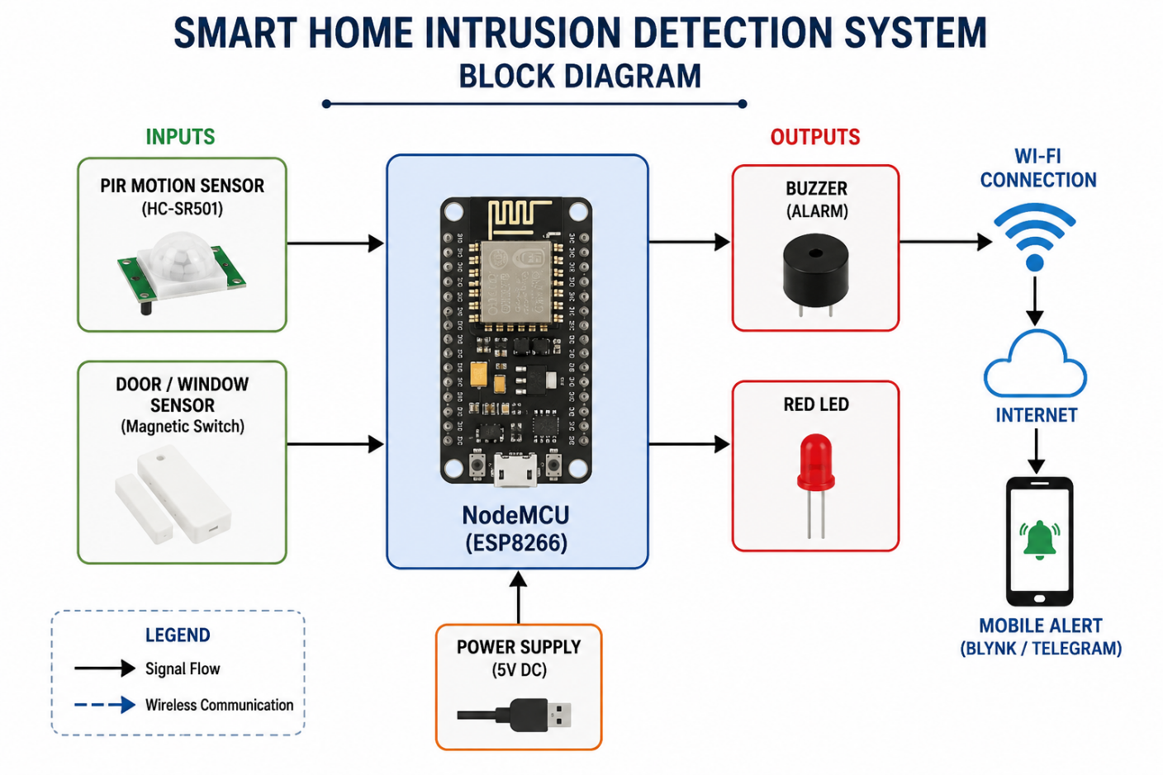
Basic Block Diagram

Slide 15
Conclusion
Conclusion
The Smart Home Intrusion Detection System provides an effective, affordable, and reliable solution for home security.
By integrating sensors with a microcontroller and IoT technology, the system can detect unauthorized access, trigger alarms, and send instant notifications to homeowners. This project demonstrates how embedded systems can enhance safety while remaining cost-effective and easy to implement.

Slide 16
References
Arduino Official Documentation
ESP32 Documentation by Espressif
PIR Motion Sensor Datasheet
IoT Security Research Papers (IEEE Xplore)
Blynk IoT Documentation
Microcontroller Embedded Systems Textbook

